Slide 1
Angular – NgRx
Peter Eijgermans peter.eijgermans@ordina.nl

Slide 2
NgRx/Redux

Slide 3
What is NgRX?
NgRx is a state management system that is based on the Redux pattern

Slide 4
State?
Application state is the entire memory of the application.
In simple terms, application state is composed of:
data received by API calls
user inputs
presentation UI state
application preferences
etc…

Slide 5
How to communicate between components?
Notes:
As you are well aware, an Angular application is typically made up of many components. Each of these components has its own state and has no awareness of the state of the other components. In order to share information between parent-child components, we use @Input and@Output decorators. However, this approach is practical only if your application consists of a few components, as shown below.

Slide 6
Don’t use @Input and @output
Use Redux !

Slide 7
Redux is based on 3 principles
1. Single source of truth

Slide 8
Redux is based on 3 principles
2. State is immutable
In order to make changes in the state, you have to dispatch actions
Notes:
It only implies that you are not allowed to change the state directly. In order to make changes in the state, you have to dispatch actions

Slide 9
Redux is based on 3 principles
3. State is modified with pure functions = via Reducers
Notes:
It only implies that you are not allowed to change the state directly. In order to make changes in the state, you have to dispatch actions

Slide 10
Fundamental Elements of NgRx
Store
Actions
Reducers
Selectors
Effects

Slide 11
Store
Each component has a reference to the store:
constructor(private store: Store<AppState>) {}
This store reference can be used to:
To dispatch actions to the store
Retrieve the application state via selectors

Slide 12
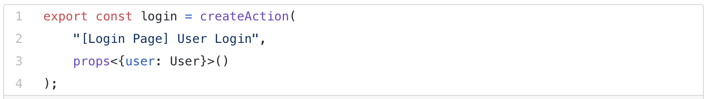
Actions
An action is an instruction that you dispatch to the store
Notes:
Based on the action type, the store decides which operations to execute.
Payload is an optional attribute that will be used by reducers to modify the state.

Slide 13
Reducers
Notes:
Reducers take in two parameters, the current state and the action

Slide 14
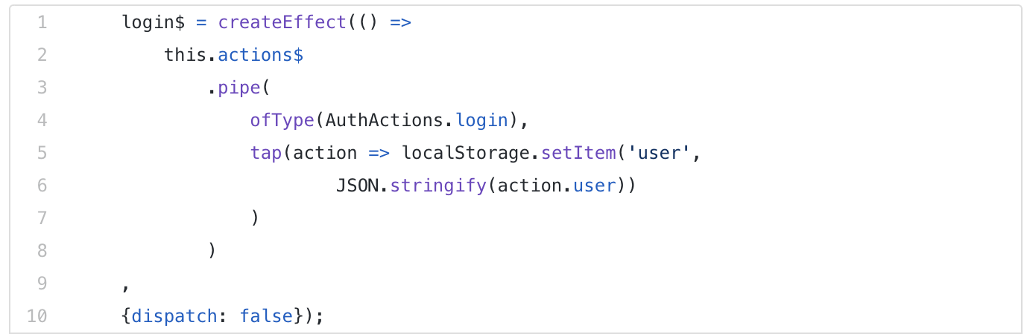
Effects
Allows you to perform side effects when an action is dispatched to the store
Use utility function “createEffect()”:
Notes:
Example!
When a user successfully logs in to an application, an action with type Login Action will be dispatched to the store with the user information in the payload. A reducer function will listen to this action and modify the state with the user information. In addition, as a side effect, you also want to save user information in the browser's local storage. An effect can be used to carry out this additional task (side effect).
Dispatch : false
These effects do not map the incoming action to a new action type, which is why {dispatch: false} config is used.

Slide 15
Selectors
Selectors are functions used for obtaining slices of the store state.

Slide 18
NgRx Entity
export interface Course {
id: string;
name: string;
description: string;
}
import { EntityState } from '@ngrx/entity’;
export interface CourseState extends EntityState<Course> { }

Slide 19
DEMO REDUX !

Slide 20
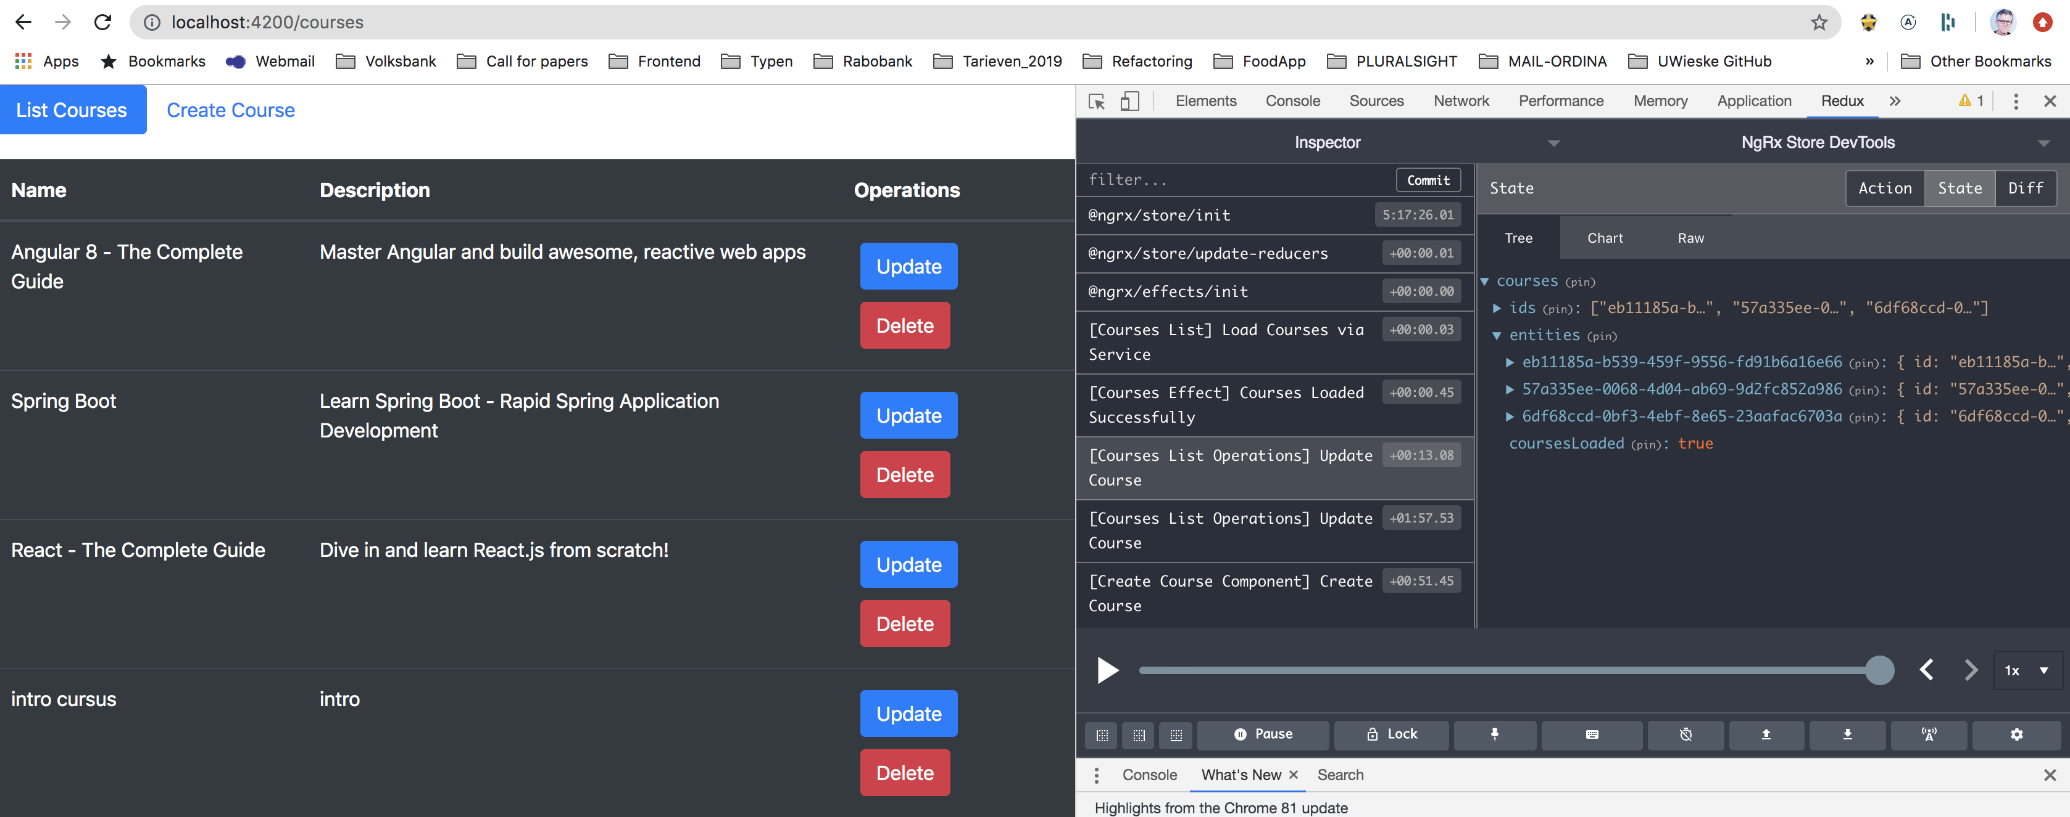
Install Redux Chrome Extension

Slide 21
NgRx/Redux tutorial
Part 1
https://medium.com/better-programming/angular-getting-started-with-ngrx-75b9139c23eb
Part 2
https://medium.com/better-programming/angular-building-a-crud-application-with-ngrx-40e5f1c0b50c

